Slide 1




SEARCH
ANALYSIS
PROJECT
Analyze and visualize Google search trends. It presents keyword performance and search insights in a clean and easy-to-understand format, helping transform raw data into meaningful insights for better decision-making.
www.google.com
Project By - Prabhat Prajapati

Slide 2

OVERVIEW OF GOOGLE
As of recent estimates (2025–2026), Google processes over 16.4 billion searches per day
Google handles more than 190,000 searches every second, which equals:
•~11.4 million searches per minute
•~16.4 billion searches per day
•~5.9 trillion searches per year
Google Trends data represents a very
reliable proxy for public interest, making it ideal for:
•Market research
•Political forecasting
•News and media analysis
•Product demand analysis

Slide 3
CREATING QUESTIONS TO SOLVE PROBLEM
If working in a data-driven job role, and you have to answer all these questions.
1) First, write a code where, by changing just the keyword, we can search for multiple things.
2) Top 15 countries where the keywords are searched the most, and also create visual representation of it.
3) A world map needs to be plotted showing the countries that search the keyword the most.
4) We need to extract the time-wise interest of the keyword — how it trended in different years.
5) Compare related keywords and plot the graph.
Analyze search trends for different keywords by allowing easy keyword changes and extracting global search data. Visualize insights using top-15 country charts, a world map, time-wise trends, and comparison graphs of related keywords.

Slide 4

ABOUT OF LIBRARYS TO USE IN PROJECT
Pandas – Data analysis, data manipulation
Matplotlib – Basic data visualization
Seaborn – Statistical visualization
Plotly – Interactive visualizations 📊
Pytrends – Pytrends is an unofficial Python library that allows easy access to Google Trends data through Google’s internal API. Since Google doesn’t provide an official public API for Trends data, Pytrends acts as a smart wrapper around Google's web interface, enabling data analysts and developers to extract trend data for various keywords, regions, and timeframes.
It is especially useful for:
•Market research
•Trend forecasting
•Competitive analysis
•Keyword research for SEO

Slide 5
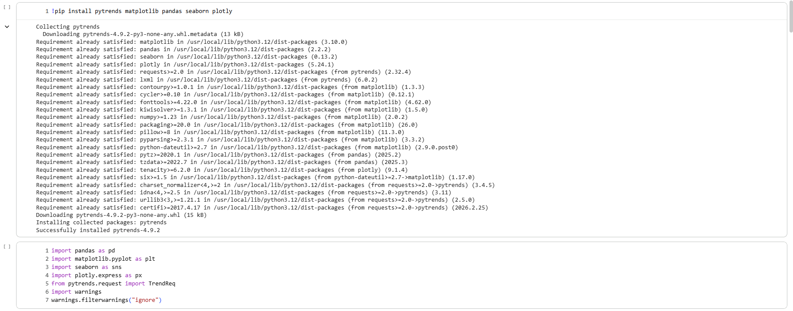
IMPORTING LIBRARIES IN PYTHON NOTEBOOK

Slide 6
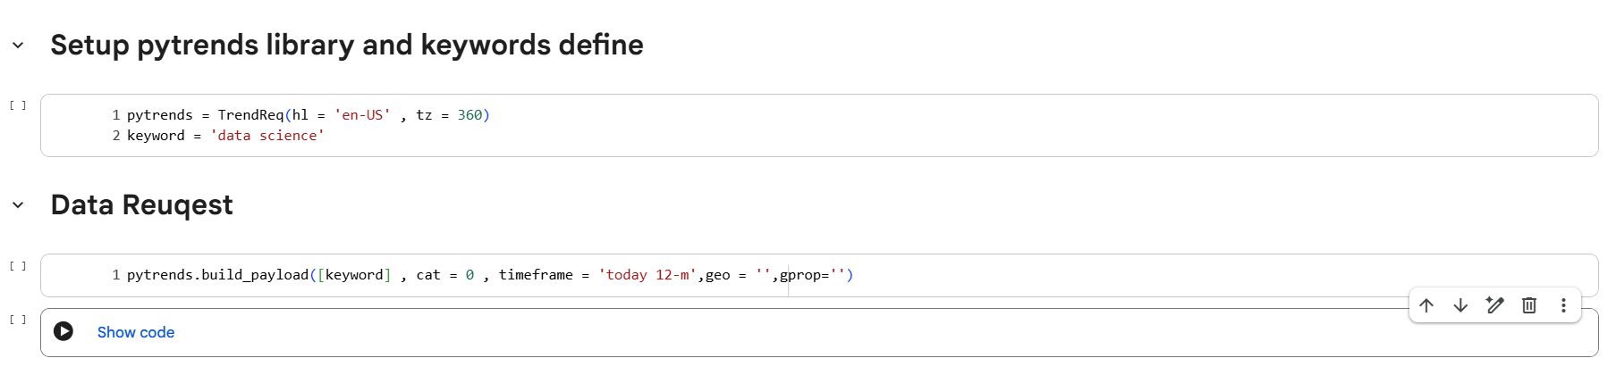
WORK ON LIBRARYS
Description of the Code:
Setup pytrends and define keyword :-
This code initializes the Pytrends connection using TrendReq and
sets the keyword "data science" to fetch search trend data from Google Trends. 🔎
Data Request (build payload) :-
The build_payload() function prepares the request to Google Trends for the selected
keyword with no category filter, global location, and last 12 months timeframe to collect search interest data. 📊🌍

Slide 7
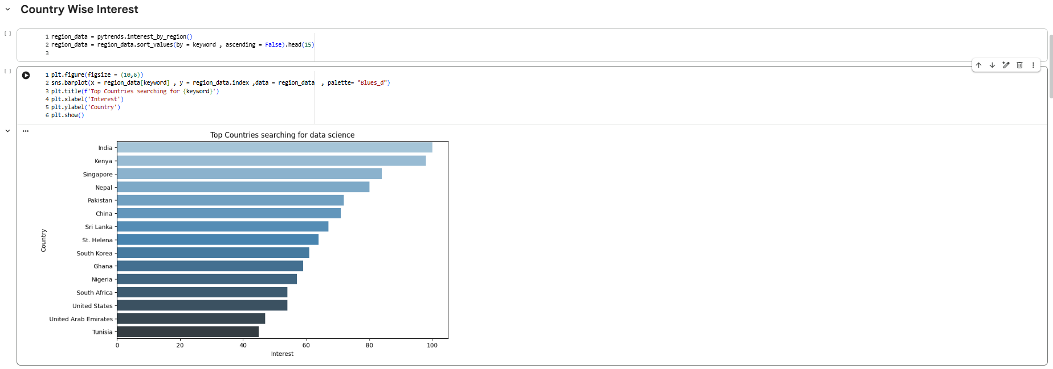
WORK ON LIBRARYS
Data Extraction: Collect country-wise search interest for the keyword and select the top 15 countries with the highest searches.
Data Visualization: Display the results using a horizontal bar chart to show which countries search the keyword the most. 📊🌍

Slide 8
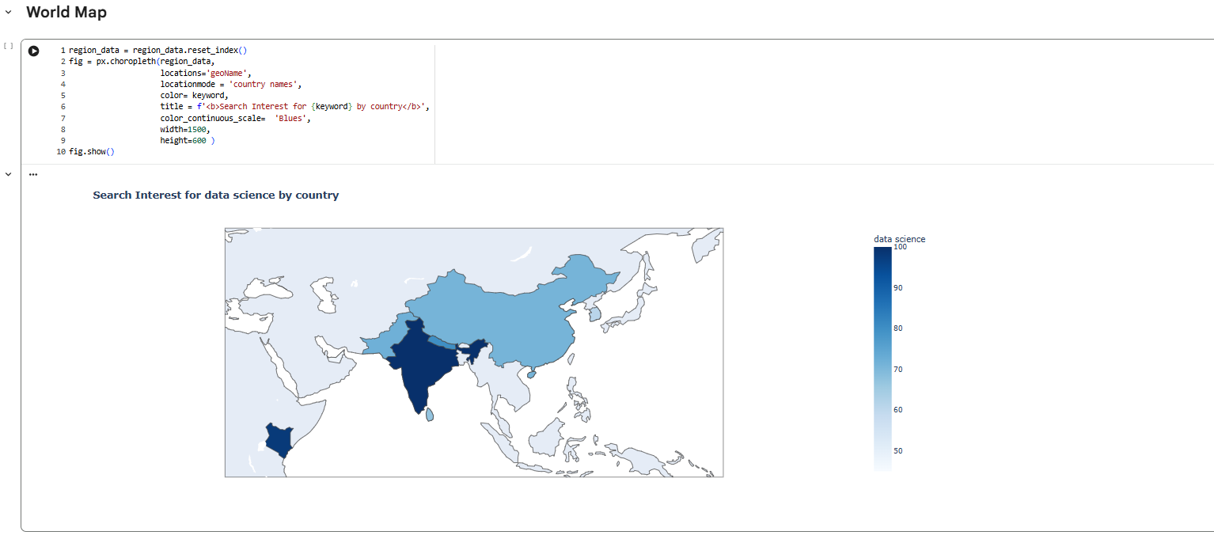
WORK ON LIBRARYS
Code: Creates a world map showing country-wise search interest for the selected keyword.
Graph: The world map shows the global distribution of search interest for the keyword. Darker shades represent higher search
interest, while lighter shades indicate lower interest, helping to easily identify the countries where the keyword is most popular.

Slide 9
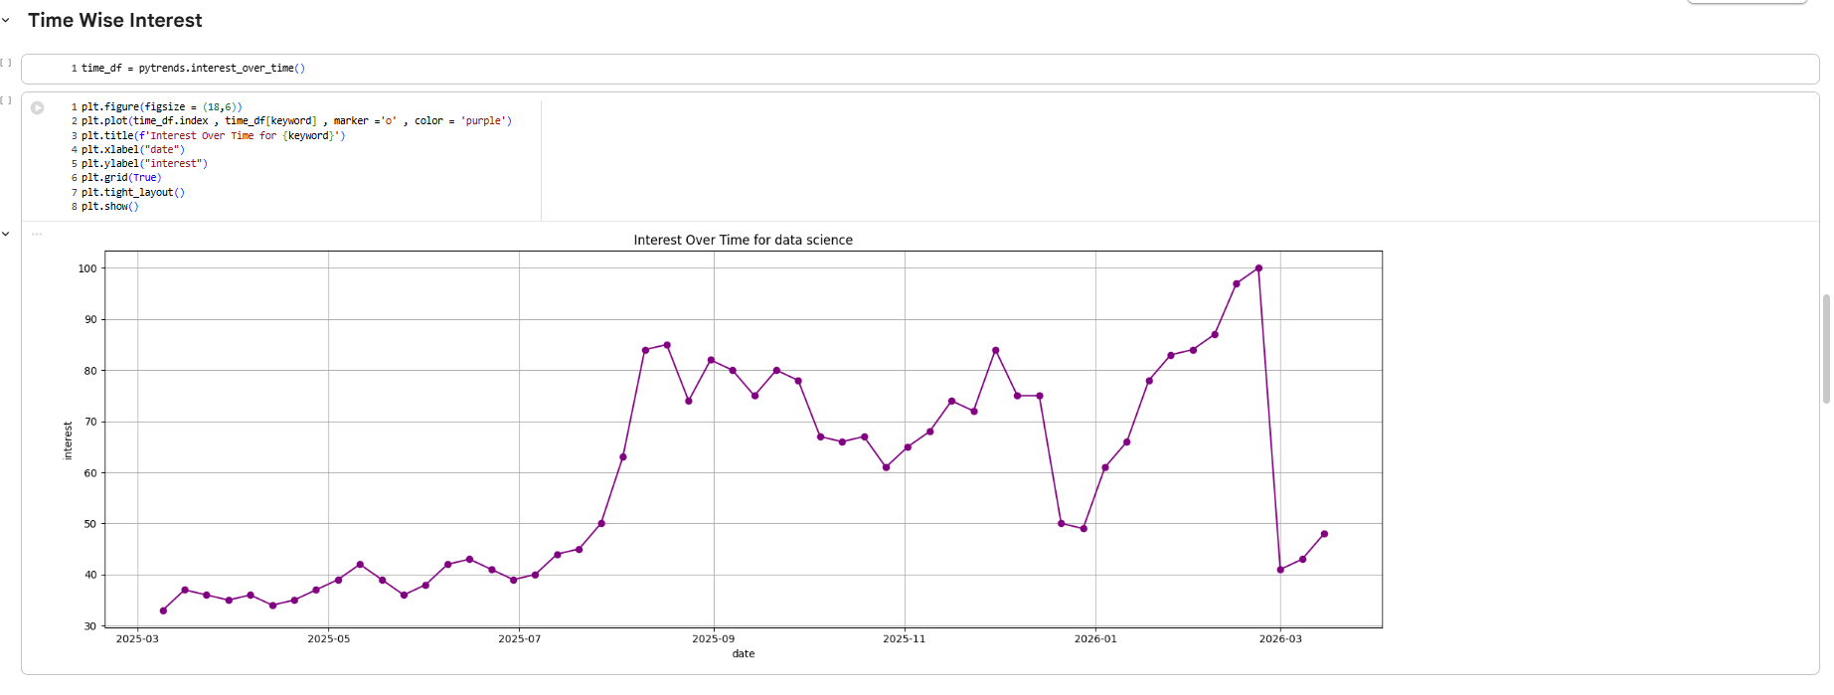
WORK ON LIBRARYS
Code: Extracts the keyword’s search interest over time and plots it against the date to analyze trends.
Graph: Shows the trend of keyword searches over time, highlighting periods of increase and decrease in interest. 📈

Slide 10
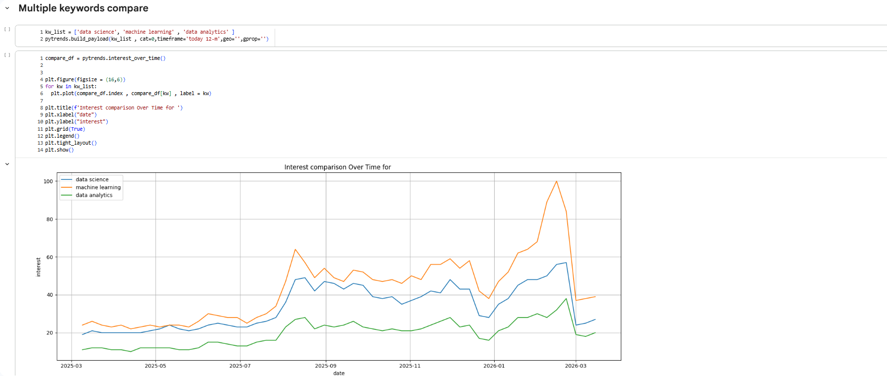
WORK ON LIBRARYS
Code: The code collects search trend data for the keywords data science, machine learning, and data analytics over the last
12 months and plots a line graph to compare their interest over time.
Graph: It shows that machine learning has the highest search popularity, followed by data science, while data analytics has
comparatively lower interest. 📈

Slide 11
EXECUTIVE SUMMARY
This project studies the popularity of data-related keywords using Google search trend data. It focuses on Data Science, Machine Learning, and Data Analytics to understand how people's interest in these topics has changed over time and which one is searched the most. The project collects data from the last 12 months and presents it using graphs so the comparison is easy to understand.
The analysis compares these keywords and shows their trends over time. The results indicate that Machine Learning has the highest search interest, followed by Data Science, while Data Analytics has lower but slowly increasing interest. This helps show current technology trends and the growing importance of data-related skills. 📊

Slide 12
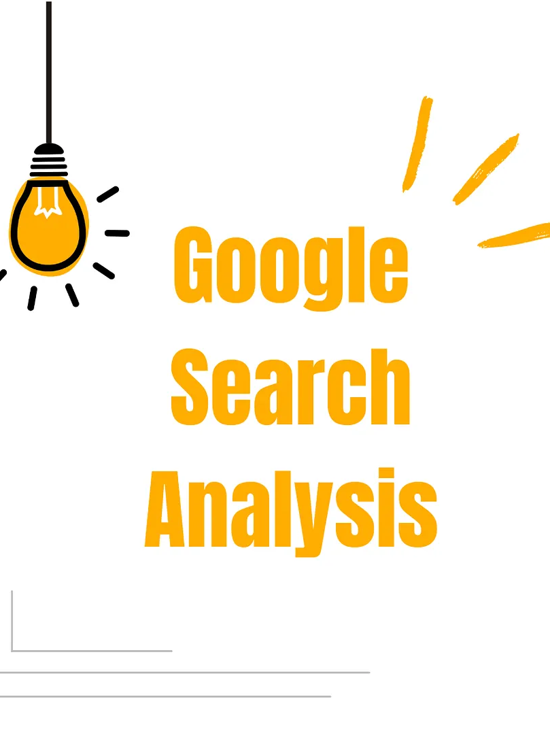
CONCLUSION
This project analyzed Google search trends for Data Science, Machine Learning, and Data Analytics over the last 12 months. The results show that Machine Learning has the highest search interest, followed by Data Science, while Data Analytics has lower but gradually increasing popularity. Overall, the analysis helps understand current technology trends and highlights the growing demand for data-related skills. 📊

Slide 13
GOOGLE SEARCH ANALYSIS
www.google.com
By - Prabhat Prajapati

